Slide 1
Project building villa (Housing units)
Project MANAGER AHMEDABDELROUF
Project stakeholders zain malek
Project team Ahmed Abdelraoof abo Elenein
Project Purpose provide all young people by housing to solve their issues
A project charter is similar to the goal, but more official, more
detailed, and in line with your company’s vision and goals.
Project results
Start to build about 800 house (villa )
About 600 will be finished by 2022.
Basic milestone timeline
January
April
May
October
November let youth to apply online for this (600) housing units only
December project completed by December 20
we will start to buy all tools that necessary for the project we will make agreement with engineers and employees began to build 600 housing units
finish all necessary electrical and paint procedures
Project resource
Budget 10000000 million
The land that is necessary for the project
Drilling equipment
Project constrains and assumptions
The project must be completed by December 20
The project must not exceed (11000000 million)
Needed to build 600 unit
The vendors should advertise this units on the TIME without affecting the project schedule
Trying to build this without legal advice
The power may be outage
Trying to build this without legal advice
The power may be outage

Slide 2
Project scope the requirements of a project define the boundaries. Requirements are the elements, conditions, services, and expectations that the project customers, stakeholders, and management expect the project to create.
Product scope description
After agreeing with young people who requested to get the housing unit
We decided to avoid high prices so we should make these housing units Available for every one
Project acceptance criteria
The villas area should be wide
The villas over looks landscapes
Chose a quite district to build these units
Project deliverables
The area is about 1000 square -foot
Every unit have garage
Project exclusion
Owner is responsible for landscape
Air conditioning is not include the project but the wire is included
Project constrains
The budget must be at least 11000000$
It required good employee and efficiency engineer
Project assumptions
All employees and engineer should work all time at different times
The tools should be modern to ensure project quality

Slide 3
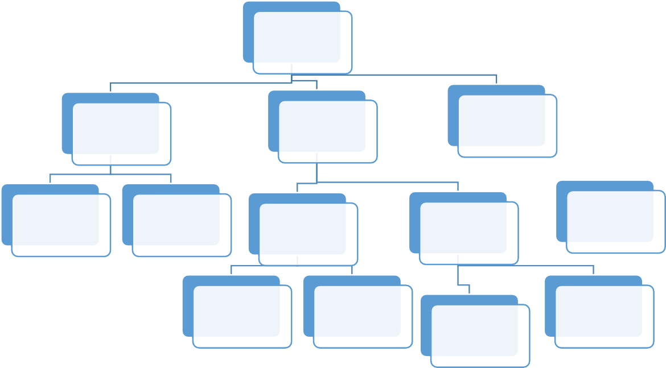
WBS is a deliverables-oriented
collection of project components. It is a categorization and decomposition of the
project scope statement
villa
sub
stracture
super structure
landscape
concrete work
soil work
roof
first floor
second floor
civil work
electronical
work
wooden work
paint work

Slide 4
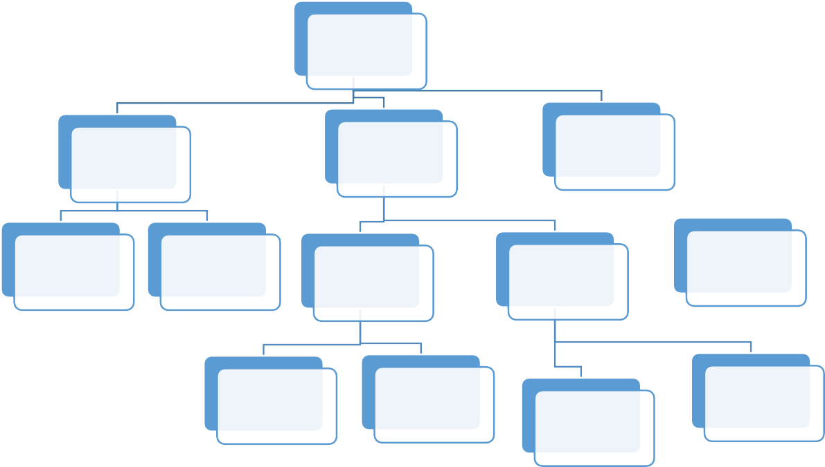
1
1.1
1.2
1.3
1.1.1
1.1.2
1.2.1
1.2.2
1.2.3
1.2.1.1
1.2.1.2
1.2.2.1
1.2.2.2

Slide 5
Work package name sub structure | Code of it 1.1
description this sub structure is that every thing about drilling operations and structure design | Who responsible drilling workers and engineers Who specialize in that work
Resources required Drilling machines Electric generator Other tools for design engineers | Coast to create it may be coast about 200000$
The WBS dictionary, as its name implies, is a dictionary that defines each work package in the WBS. You’ll use the WBS dictionary to clearly identify what the components of the WBS are and how they relate to the project scope
Work package name super structure | Code of it 1.2
Description is an upward extension of an existing structure above a baseline | Who responsible project manager is responsible for this task as it the most important one and the vendors
Resources required the main resource needed is money and civil engineers and certainly it need the main equipment for complete the work and | Coast to create this task will take a big budget as it important like it may be coast about 5000000$

Slide 6
Work package name soil work | Code of it 1.1.2
description the soil is the main resource for this project it determined the validity of that soil to complete the project | Who responsible drilling workers and agriculture engineers
Resources required Drilling machines Chemistry laboratories to examine that soil • | Coast to create it may be coast about 2000000$
Work package name electrical work | Code of it 1.2.1.2
description electrical work is every thing about electricity like electrical switches and panels that control all devices in the house | Who responsible Electrical engineering The project manager

Slide 7
Resources required Modern electrical equipment and switches Electric generator | Coast to create it may be coast about 2000000$
Work package name paint works | Code of it 1.2.2.2
description paint work is considered important stage for finishing the units to be suitable for using | Who responsible Paint workers Interior engineer The vendors who responsible for units
Resources required Equipment of paint Paint roller The colors of each room | Coast to create it may be coast about 1000000$

Slide 8
Responsibility matrix
 | Engineers | Stakeholders | Vendors | Project manager
Sub structure | C | R | V | R
Super structure | C | S
Soil work | C |  |  | V
Electrical work | R
Paint works | C | V | R | A
Concrete work | C | C
Civil work | R |  | A
Wooden work | C |  | A | V
R=responsible
A=accountable
v =verified
S=supportive
C =consulted

Slide 9
B C D
E
f
A
G H
J
2

Slide 10
sub structure
soil work
CONCRETE
work
villa
landscape
floors
finish
super structure
roof

Slide 11
Activity | Description | Activity time
A | VILLA (define requirement ) | 15
B | Substructure | 20
c | Landscape | 6
D | superstructure | 20
E | Soil work | 17
F | Concrete work | 5
G | Floors | 10
H | roof | 7
J | FINISHES | 1

Slide 12
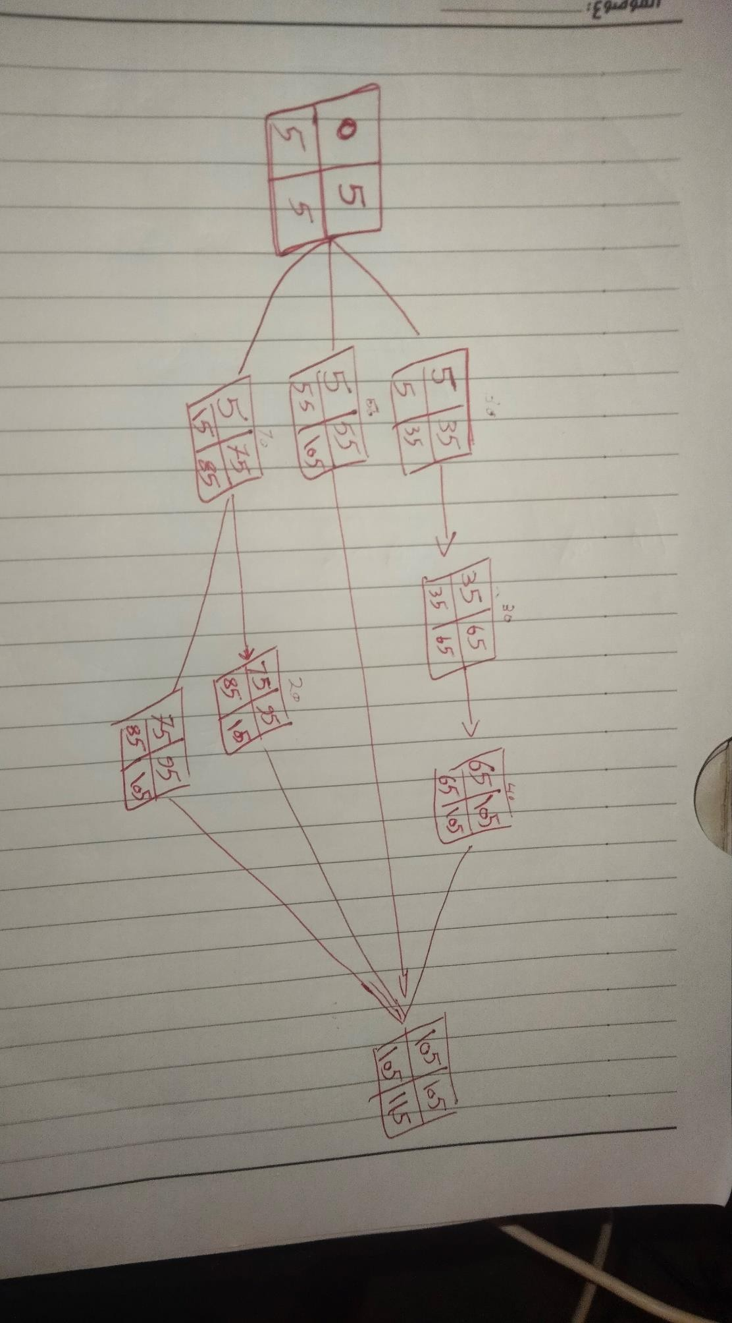

Slide 13
Id
A |  |  | 15
B |  |  | 20
C |  |  | 6
D |  |  | 6 | 6 | 8
E |  |  | 10 | 5 | 2
F |  |  | 3 | 2
G |  |  | 3 | 2 | 5
H |  |  | 4 | 3
J |  |  | 17
Id
A |  |  | 15
B |  |  | 20
C |  |  | 6
D |  |  | 6 | 6 | 8
E |  |  | 10 | 5 | 2
F |  |  | 3 | 2
G |  |  | 3 | 2 | 5
H |  |  | 4 | 3
J |  |  | 17

Slide 14
BASELINE BU
ID | BUDGET | 1 | 2 | 3 | 4 | 5 | 6 | 7 | 8 | 9 | 10 | 11
A | 15 | 15
B | 20 |  | 5
C | 6 |  | 6
D | 20 |  | 6 | 8 | 6
E | 17 |  |  |  | 10 | 7
F | 5 |  |  |  |  |  | 3 | 2
G | 10 |  |  |  |  |  | 3 | 2 | 5
H | 7 |  |  |  |  |  |  |  | 4 | 3
J | 17 |  |  |  |  |  |  |  |  | 10 | 7

Slide 15
TOTAL | 102 | 15 | 17 | 8 | 16 | 7 | 6 | 4 | 9 | 13 | 7
 |  | 15 | 32 | 40 | 56 | 63 | 69 | 73 | 82 | 95 | 102
DGET
BASELINE BU
ID | BUDGET | 1 | 2 | 3 | 4 | 5 | 6 | 7 | 8 | 9 | 10 | 11
A | 15 | 15
B | 20 |  | 5
C | 6 |  | 6
D | 20 |  | 6 | 8 | 6
E | 17 |  |  |  | 10 | 7
F | 5 |  |  |  |  |  | 3 | 2
G | 10 |  |  |  |  |  | 3 | 2 | 5

Slide 16
H | 7 |  |  |  |  |  |  |  | 4 | 3
J | 17 |  |  |  |  |  |  |  |  | 10 | 7
TOTAL | 102 | 15 | 17 | 8 | 16 | 7 | 6 | 4 | 9 | 13 | 7
 |  | 15 | 32 | 40 | 56 | 63 | 69 | 73 | 82 | 95 | 102
DGET

